Slide 1
MCA FINAL YEAR PROJECT
Art Gallery Management System
UML Class Diagram · ER Diagram · Data Dictionary
Detail | Information
Student Name | [ Enter Student Name ]
Enrollment Number | [ Enter Enrollment Number ]
College Name | [ Enter College Name ]
Guide Name | [ Enter Guide Name ]
Academic Year | [ Enter Academic Year ]
Art Gallery Management System | MCA Final Year Project
1 / 43

Slide 2
Project Introduction
The Art Gallery Management System is a web-based application developed to manage information related to artists, artworks, categories, exhibitions, and visitor inquiries.
The system provides a centralized platform for managing gallery information and allows visitors to explore artworks and contact the gallery.
It is designed as an MCA final-year individual project using React.js on the frontend and ASP.NET Core Web API with SQL Server on the backend.
Art Gallery Management System | MCA Final Year Project
2 / 43

Slide 3
Problem Statement
Traditional art gallery information management can involve manual records or scattered information.
It becomes difficult to manage:
• Artists and their profile details
• Artworks and their categories
• Exhibitions and assigned artworks
• Visitor inquiries and follow-up status
Proposed solution: A centralized web-based Art Gallery Management System with secure login, role-based access, and a clear database design for gallery data.
Art Gallery Management System | MCA Final Year Project
3 / 43

Slide 4
Project Objectives
• Develop a web-based Art Gallery Management System.
• Manage artist information.
• Manage artwork information and organize categories.
• Manage exhibitions and artwork assignments.
• Allow visitors to explore artworks.
• Allow visitors to submit inquiries.
• Implement secure authentication using JWT and ASP.NET Core Identity.
• Implement role-based access control (Admin, Artist, Visitor).
Art Gallery Management System | MCA Final Year Project
4 / 43

Slide 5
Technology Stack
Frontend
Backend
Database
Authentication
React.js
TypeScript
Vite
Tailwind CSS
ASP.NET Core Web API
C#
Entity Framework Core
Microsoft SQL Server
Database-first SQL scripts
ASP.NET Core Identity
JWT Authentication
Cloud / Deployment (optional later): Microsoft Azure App Service, Azure SQL Database, Azure Blob Storage.
Art Gallery Management System | MCA Final Year Project
5 / 43

Slide 6
System Users and Roles
Admin
Manage artists, categories, artworks, exhibitions, users, and inquiries.
Full system administration.
Artist
Login account with Artist role.
Planned: view/update profile and own artworks (Artist Dashboard).
Visitor
Browse public gallery pages.
Submit contact inquiries.
Optional registration.
Art Gallery Management System | MCA Final Year Project
6 / 43

Slide 7
System Modules
Category | Modules
Core Modules | Authentication, User Management, Artist, Category, Artwork, Exhibition, Inquiry
Public Modules | Home Page, Public Gallery, Artwork browsing, Contact / Inquiry
Planned Extended | Artist Dashboard, Search and Filtering, API-backed gallery details
Future Scope | Purchase, Payment, Cart, Mobile App, AI Recommendations, Virtual Gallery
Note: Planned modules remain part of the project blueprint even if implemented later.
Art Gallery Management System | MCA Final Year Project
7 / 43

Slide 8
System Architecture
React Frontend
UI, forms, routing, JWT storage
↓
ASP.NET Core Web API
Controllers, services, validation, JWT auth
↓
Entity Framework Core + Identity
Data access and user authentication
↓
Microsoft SQL Server
Persistent storage (database-first scripts)
Optional later: Azure App Service → Azure SQL Database / Blob Storage
Art Gallery Management System | MCA Final Year Project
8 / 43

Slide 9
UML Class Diagram — Introduction
The UML Class Diagram represents the main classes and relationships used in the backend application.
Core entities
• ApplicationUser (inherits IdentityUser<Guid>) — implemented
• Artist, Category, Artwork, Exhibition, ExhibitionArtwork, Inquiry — planned domain model
Enums
• ArtworkStatus: Available, Sold, Displayed, Archived
• InquiryStatus: New, Read, Responded, Closed
Roles are managed by ASP.NET Core Identity (AspNetRoles / AspNetUserRoles), not as a string field on ApplicationUser.
Art Gallery Management System | MCA Final Year Project
9 / 43

Slide 10
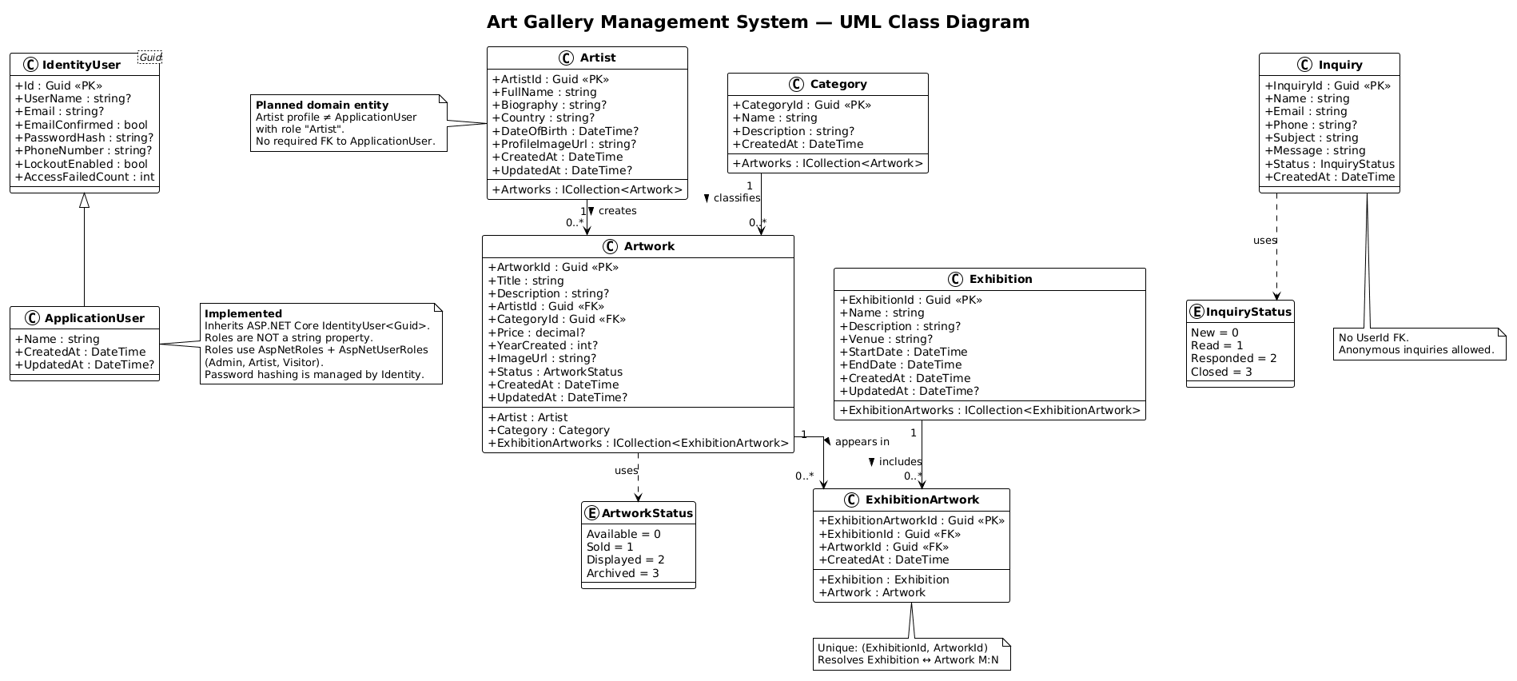
UML Class Diagram
Art Gallery Management System | MCA Final Year Project
10 / 43

Slide 11
UML Relationship Explanation
Relationship | Multiplicity | Simple meaning
Artist → Artwork | 1 → Many | One artist can create many artworks
Category → Artwork | 1 → Many | One category can contain many artworks
Exhibition → ExhibitionArtwork | 1 → Many | One exhibition has many artwork links
Artwork → ExhibitionArtwork | 1 → Many | One artwork can appear in many exhibitions
Exhibition ↔ Artwork | Many ↔ Many | Resolved using ExhibitionArtwork junction
ApplicationUser and Artist are separate. Inquiry has no required link to a logged-in user.
Art Gallery Management System | MCA Final Year Project
11 / 43

Slide 12
ER Diagram — Introduction
The ER Diagram represents the database structure used by the system.
It shows:
• Tables, Primary Keys (PK), and Foreign Keys (FK)
• Relationships and cardinality
• Identity tables for authentication (AspNetUsers, AspNetRoles, AspNetUserRoles)
• Planned business tables: Artists, Categories, Artworks, Exhibitions, ExhibitionArtworks, Inquiries
Authentication and role management use ASP.NET Core Identity. Internal Identity tables are summarized for academic clarity.
Art Gallery Management System | MCA Final Year Project
12 / 43

Slide 13
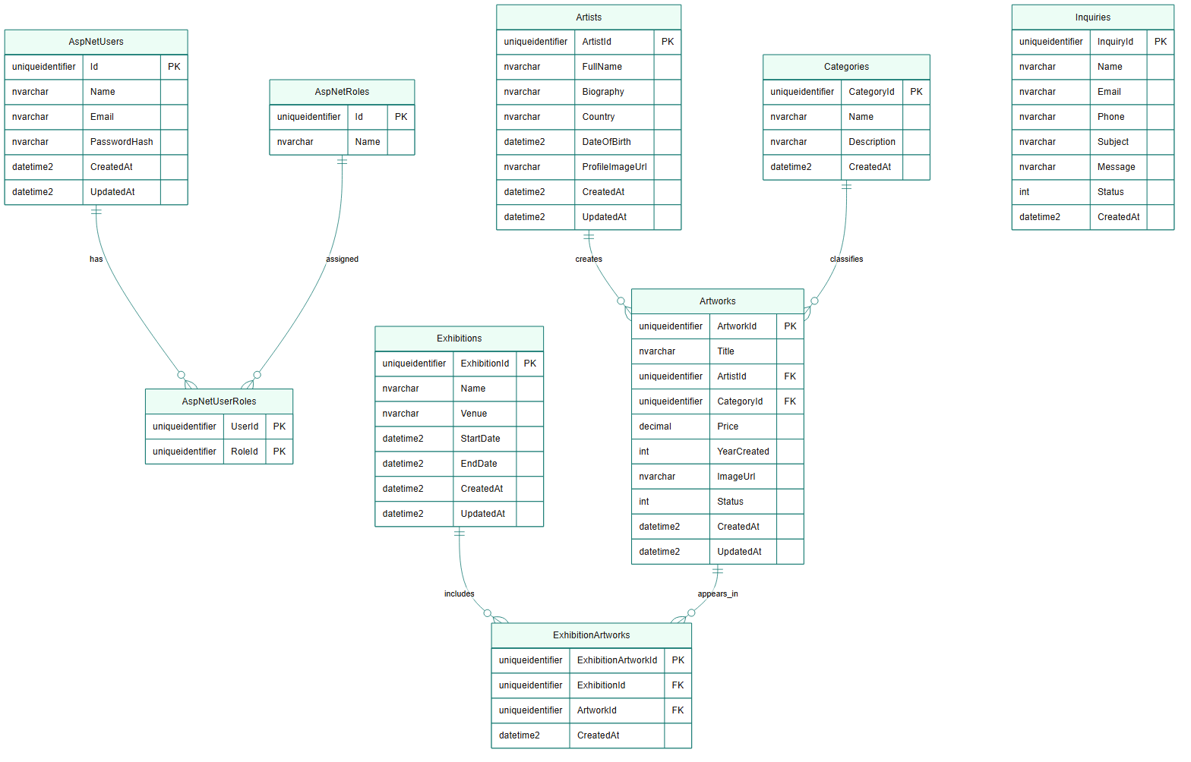
ER Diagram
Art Gallery Management System | MCA Final Year Project
13 / 43

Slide 14
Database Relationships
Parent Table | Child Table | Relationship
Artists | Artworks | One-to-Many
Categories | Artworks | One-to-Many
Exhibitions | ExhibitionArtworks | One-to-Many
Artworks | ExhibitionArtworks | One-to-Many
AspNetUsers / AspNetRoles | AspNetUserRoles | Many-to-Many (Identity)
Exhibition and Artwork have a Many-to-Many relationship through the ExhibitionArtworks junction table. Unique constraint: (ExhibitionId, ArtworkId).
Art Gallery Management System | MCA Final Year Project
14 / 43

Slide 15
Data Dictionary — Overview
The Data Dictionary defines every database field used by the Art Gallery Management System.
Table | Purpose
AspNetUsers | Login users (ASP.NET Core Identity / ApplicationUser)
AspNetRoles | Roles: Admin, Artist, Visitor
AspNetUserRoles | User–Role mapping
Artists | Artist gallery profiles
Categories | Artwork categories
Artworks | Artwork records
Exhibitions | Exhibition events
ExhibitionArtworks | Exhibition ↔ Artwork junction
Inquiries | Visitor contact messages
Art Gallery Management System | MCA Final Year Project
15 / 43

Slide 16
Data Dictionary — AspNetUsers (1/2)
ApplicationUser storage. No Role column — roles use AspNetUserRoles.
Field Name | Data Type | Null | Key | Description
Id | uniqueidentifier | No | PK | User primary key (Identity)
Name | nvarchar(80) | No | - | Display name (custom field)
UserName | nvarchar(256) | Yes | - | Identity user name
NormalizedUserName | nvarchar(256) | Yes | UQ | Normalized user name
Email | nvarchar(256) | Yes | - | Email address
NormalizedEmail | nvarchar(256) | Yes | UQ | Normalized email
EmailConfirmed | bit | No | - | Email confirmation flag (default 0)
PasswordHash | nvarchar(MAX) | Yes | - | Identity password hash
SecurityStamp | nvarchar(MAX) | Yes | - | Identity security stamp
Art Gallery Management System | MCA Final Year Project
16 / 43

Slide 17
Data Dictionary — AspNetUsers (2/2)
Field Name | Data Type | Null | Key | Description
ConcurrencyStamp | nvarchar(MAX) | Yes | - | Concurrency token
PhoneNumber | nvarchar(MAX) | Yes | - | Optional phone
PhoneNumberConfirmed | bit | No | - | Phone confirmation (default 0)
TwoFactorEnabled | bit | No | - | 2FA flag (default 0)
LockoutEnd | datetimeoffset | Yes | - | Lockout end time
LockoutEnabled | bit | No | - | Lockout enabled (default 1)
AccessFailedCount | int | No | - | Failed login count (default 0)
CreatedAt | datetime2(3) | No | - | Account created UTC (SYSUTCDATETIME)
UpdatedAt | datetime2(3) | Yes | - | Last update UTC
Art Gallery Management System | MCA Final Year Project
17 / 43

Slide 18
Data Dictionary — AspNetRoles
Stores application roles: Admin, Artist, Visitor.
Field Name | Data Type | Null | Key | Description
Id | uniqueidentifier | No | PK | Role id
Name | nvarchar(256) | Yes | - | Role name
NormalizedName | nvarchar(256) | Yes | UQ | Normalized role name
ConcurrencyStamp | nvarchar(MAX) | Yes | - | Concurrency token
Art Gallery Management System | MCA Final Year Project
18 / 43

Slide 19
Data Dictionary — AspNetUserRoles
Many-to-many link between users and roles.
Field Name | Data Type | Null | Key | Description
UserId | uniqueidentifier | No | PK, FK | → AspNetUsers.Id
RoleId | uniqueidentifier | No | PK, FK | → AspNetRoles.Id
Art Gallery Management System | MCA Final Year Project
19 / 43

Slide 20
Data Dictionary — Artists
Planned gallery artist profile table (separate from login user).
Field Name | Data Type | Null | Key | Description
ArtistId | uniqueidentifier | No | PK | Unique artist id
FullName | nvarchar(150) | No | - | Artist full name
Biography | nvarchar(MAX) | Yes | - | Biography
Country | nvarchar(100) | Yes | - | Country
DateOfBirth | datetime2 | Yes | - | Date of birth
ProfileImageUrl | nvarchar(500) | Yes | - | Profile image URL/path
CreatedAt | datetime2 | No | - | Created (UTC)
UpdatedAt | datetime2 | Yes | - | Updated (UTC)
Art Gallery Management System | MCA Final Year Project
20 / 43

Slide 21
Data Dictionary — Categories
Planned artwork category table.
Field Name | Data Type | Null | Key | Description
CategoryId | uniqueidentifier | No | PK | Unique category id
Name | nvarchar(100) | No | UQ | Category name
Description | nvarchar(500) | Yes | - | Description
CreatedAt | datetime2 | No | - | Created (UTC)
Art Gallery Management System | MCA Final Year Project
21 / 43

Slide 22
Data Dictionary — Artworks
Planned artwork table. Status uses ArtworkStatus enum (int).
Field Name | Data Type | Null | Key | Description
ArtworkId | uniqueidentifier | No | PK | Unique artwork id
Title | nvarchar(200) | No | - | Title
Description | nvarchar(MAX) | Yes | - | Description
ArtistId | uniqueidentifier | No | FK | → Artists.ArtistId
CategoryId | uniqueidentifier | No | FK | → Categories.CategoryId
Price | decimal(18,2) | Yes | - | Price
YearCreated | int | Yes | - | Year created
ImageUrl | nvarchar(500) | Yes | - | Image URL/path
Status | int | No | - | ArtworkStatus (default 0 Available)
CreatedAt | datetime2 | No | - | Created (UTC)
UpdatedAt | datetime2 | Yes | - | Updated (UTC)
Art Gallery Management System | MCA Final Year Project
22 / 43

Slide 23
Data Dictionary — Exhibitions
Planned exhibition table.
Field Name | Data Type | Null | Key | Description
ExhibitionId | uniqueidentifier | No | PK | Unique exhibition id
Name | nvarchar(200) | No | - | Exhibition name
Description | nvarchar(MAX) | Yes | - | Description
Venue | nvarchar(200) | Yes | - | Venue
StartDate | datetime2 | No | - | Start date
EndDate | datetime2 | No | - | End date
CreatedAt | datetime2 | No | - | Created (UTC)
UpdatedAt | datetime2 | Yes | - | Updated (UTC)
Art Gallery Management System | MCA Final Year Project
23 / 43

Slide 24
Data Dictionary — ExhibitionArtworks
Junction table. Unique constraint: (ExhibitionId, ArtworkId).
Field Name | Data Type | Null | Key | Description
ExhibitionArtworkId | uniqueidentifier | No | PK | Junction row id
ExhibitionId | uniqueidentifier | No | FK | → Exhibitions.ExhibitionId
ArtworkId | uniqueidentifier | No | FK | → Artworks.ArtworkId
CreatedAt | datetime2 | No | - | Link created (UTC)
Art Gallery Management System | MCA Final Year Project
24 / 43

Slide 25
Data Dictionary — Inquiries
Visitor inquiries. No UserId FK — anonymous contact allowed.
Field Name | Data Type | Null | Key | Description
InquiryId | uniqueidentifier | No | PK | Unique inquiry id
Name | nvarchar(150) | No | - | Visitor name
Email | nvarchar(256) | No | - | Visitor email
Phone | nvarchar(30) | Yes | - | Optional phone
Subject | nvarchar(200) | No | - | Subject
Message | nvarchar(MAX) | No | - | Message
Status | int | No | - | InquiryStatus (default 0 New)
CreatedAt | datetime2 | No | - | Submitted (UTC)
Art Gallery Management System | MCA Final Year Project
25 / 43

Slide 26
Data Dictionary — Enums
ArtworkStatus
InquiryStatus
Value | Int | Description
Available | 0 | Available
Sold | 1 | Sold
Displayed | 2 | Currently displayed
Archived | 3 | Archived
Value | Int | Description
New | 0 | Newly submitted
Read | 1 | Reviewed
Responded | 2 | Gallery responded
Closed | 3 | Closed
Art Gallery Management System | MCA Final Year Project
26 / 43

Slide 27
Important Database Design Decisions
Primary Keys
GUID (uniqueidentifier) — consistent with ASP.NET Identity
Artist vs User
Artist profile and login user are separate concepts
ExhibitionArtwork
Junction table to solve Exhibition ↔ Artwork many-to-many
Enums
ArtworkStatus and InquiryStatus stored as int
Image Storage
Database stores URL/path; files may use Azure Blob later
Identity Roles
Roles via AspNetRoles / AspNetUserRoles (not a Role string column)
Art Gallery Management System | MCA Final Year Project
27 / 43

Slide 28
Current Implementation Status
Module | Status
Authentication (Identity + JWT) | Implemented
Home / Public Website | Implemented
User Management (list visitors/artists) | Implemented
Public Gallery (Explore UI) | Implemented (mock data)
Contact form UI | Implemented (API pending)
Artist Dashboard (basic page) | In Progress
Artist Management (domain CRUD) | Planned
Category / Artwork / Exhibition | Planned
Inquiry Management (admin + API) | Planned
Art Gallery Management System | MCA Final Year Project
28 / 43

Slide 29
Future Scope
These are future enhancements. They are not required for the initial MCA implementation and are not added to the current ER diagram.
• Online artwork purchasing
• Mobile application
• Payment gateway integration
• AI-based recommendations
• Shopping cart / wishlist
• Virtual gallery tour
• Artwork reviews and ratings
• Multi-language support / advanced reports
Art Gallery Management System | MCA Final Year Project
29 / 43

Slide 30
Conclusion
The Art Gallery Management System provides a centralized web-based solution for managing gallery information.
The proposed system includes:
• Secure authentication and role-based access
• Artist, artwork, category, and exhibition management (planned modules documented)
• Visitor inquiry management
• Clear UML, ER, and Data Dictionary for database design
The modular architecture allows additional features to be added in the future without redesigning the core database.
Art Gallery Management System | MCA Final Year Project
30 / 43

Slide 31
Frontend Screenshots
The following slides show the implemented frontend screens in order.
11 screenshots from the Screen Shots folder
Art Gallery Management System | MCA Final Year Project
31 / 43

Slide 32
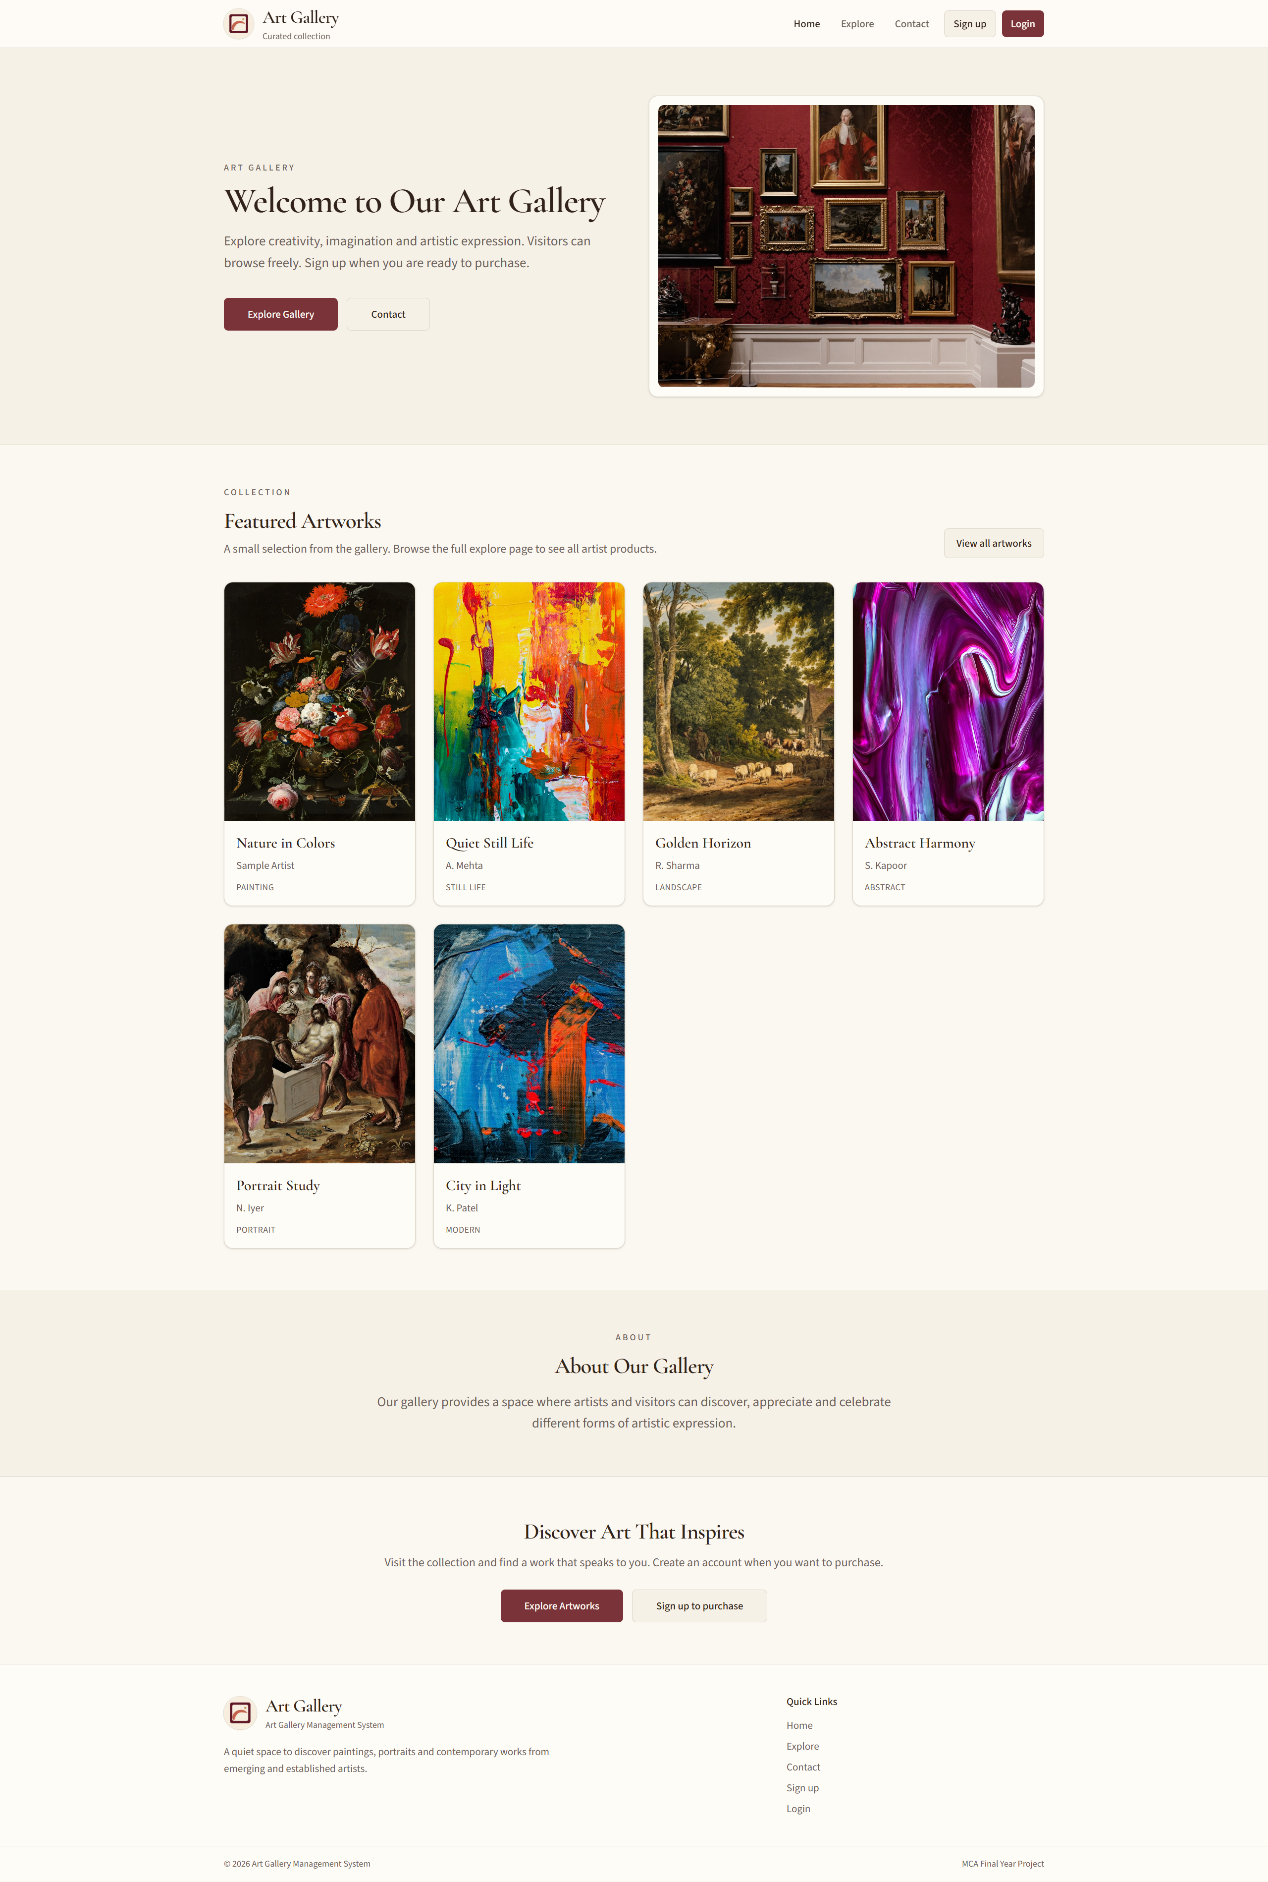
1. Home Page
Art Gallery Management System | MCA Final Year Project
32 / 43

Slide 33
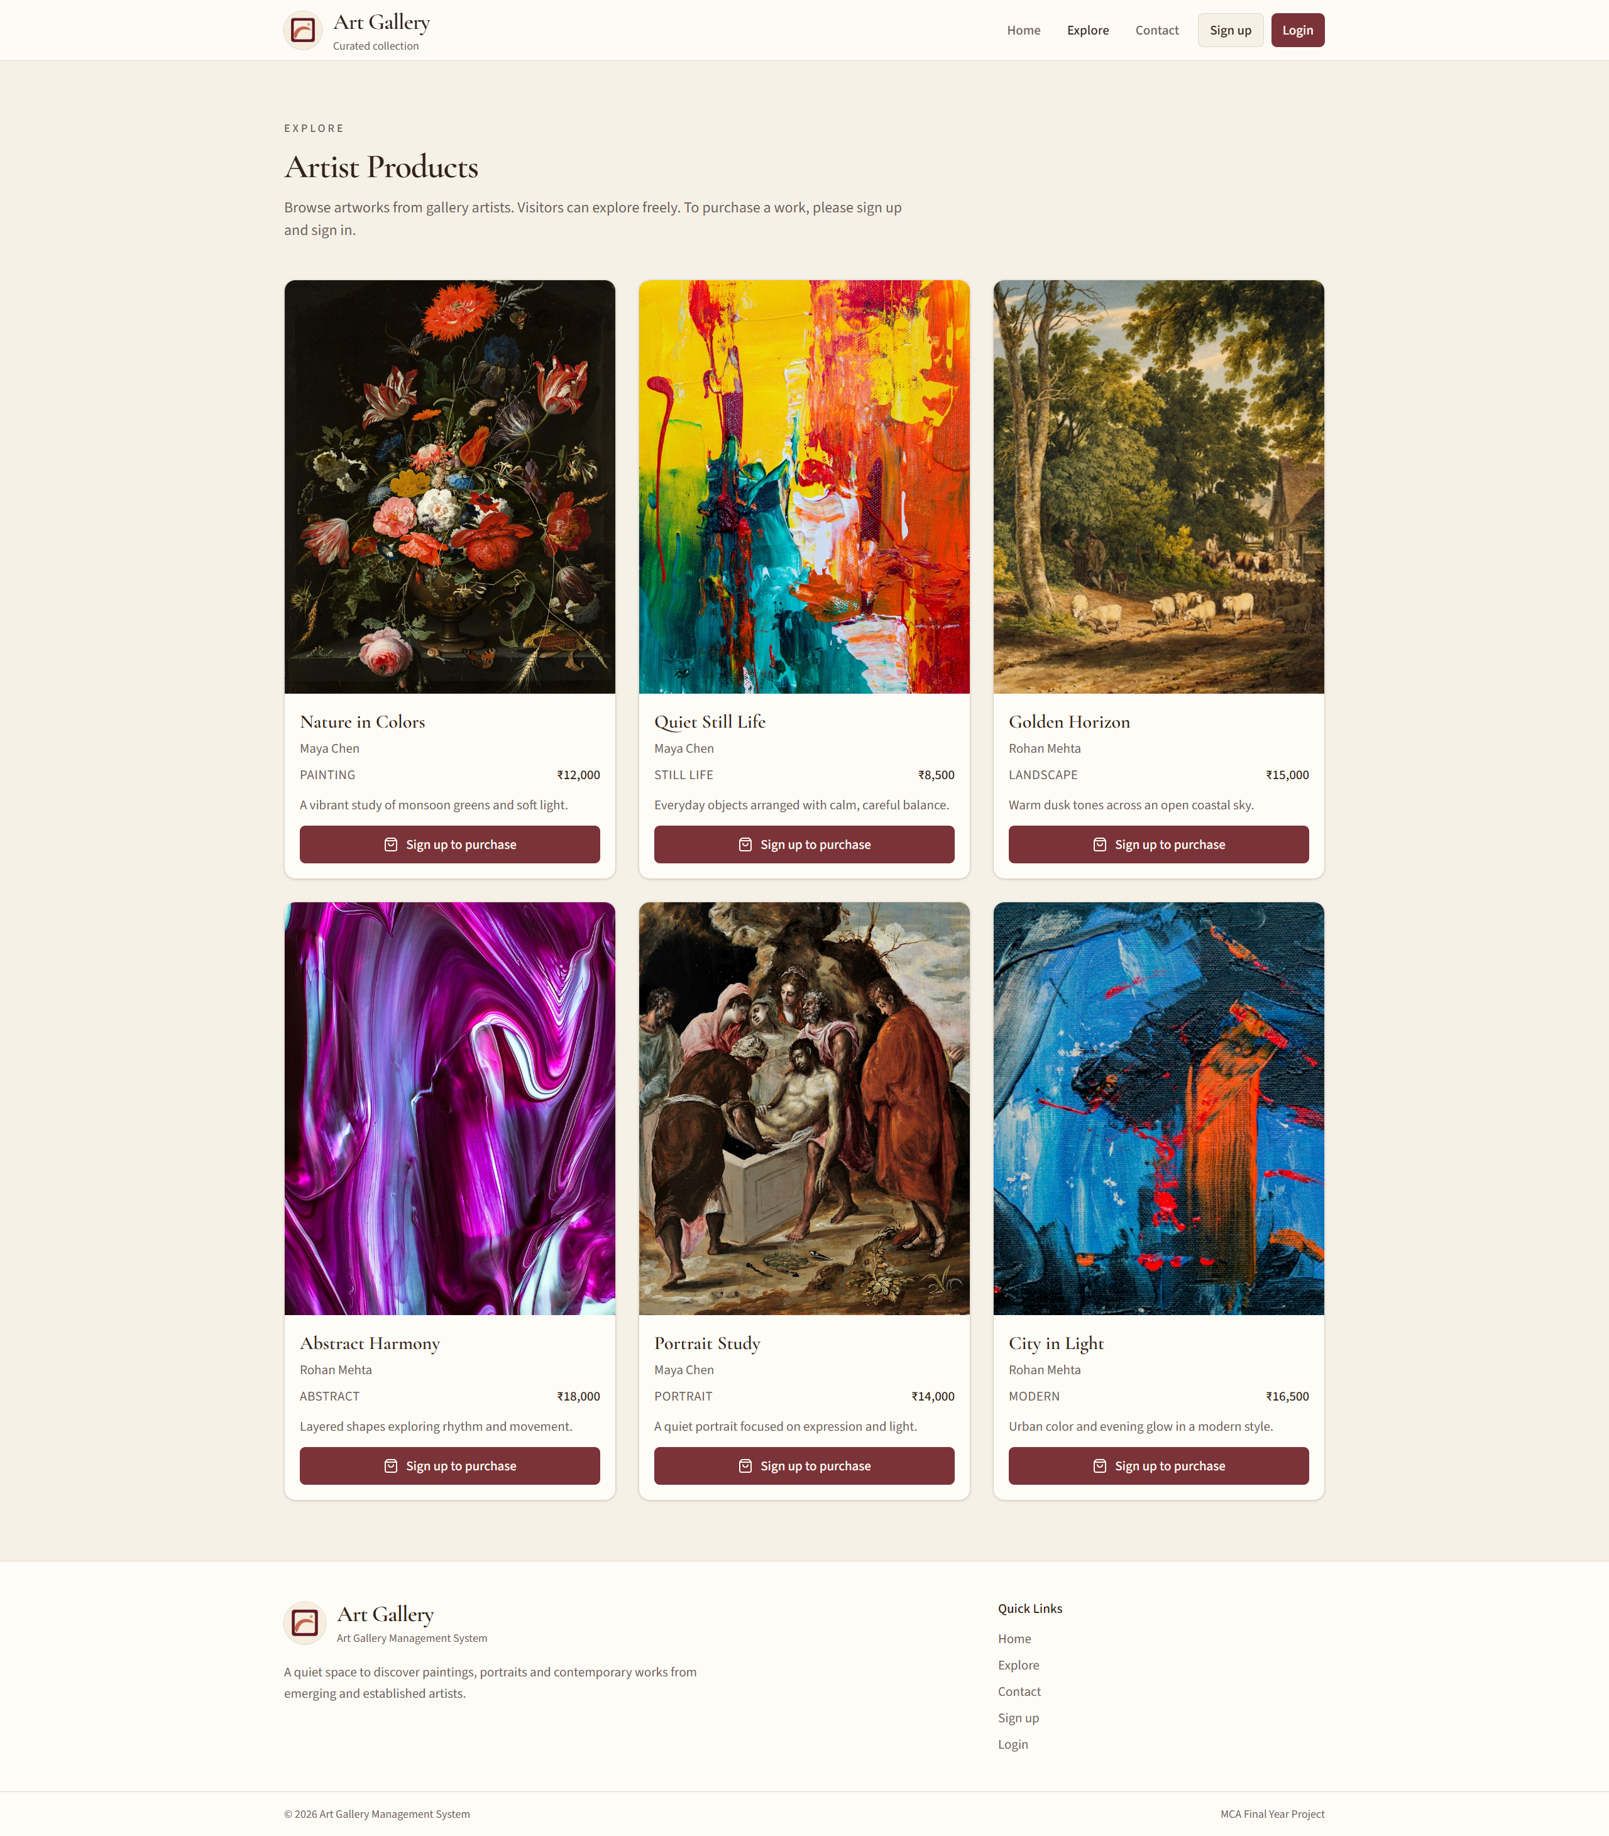
2. Explore Page
Art Gallery Management System | MCA Final Year Project
33 / 43

Slide 34
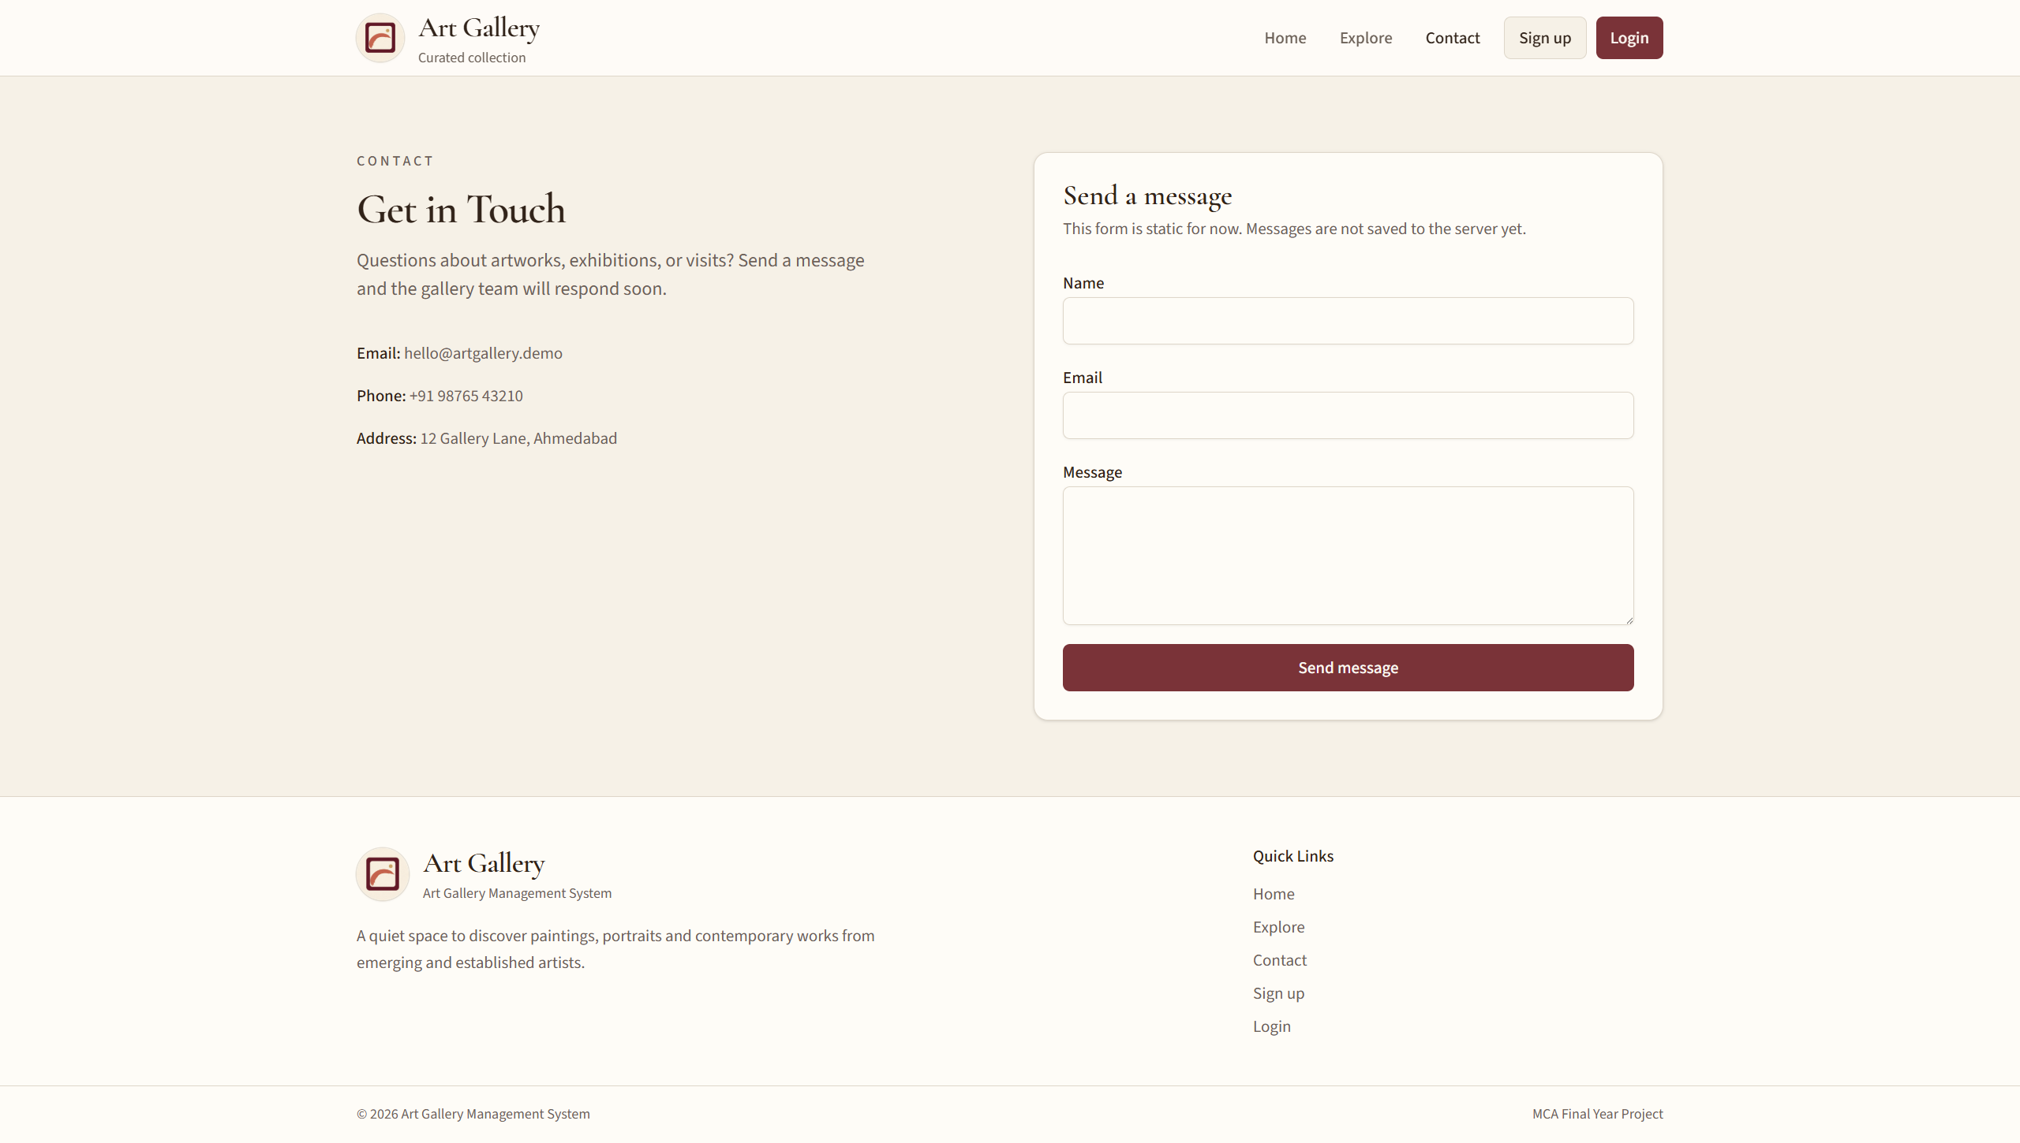
3. Contact Page
Art Gallery Management System | MCA Final Year Project
34 / 43

Slide 35
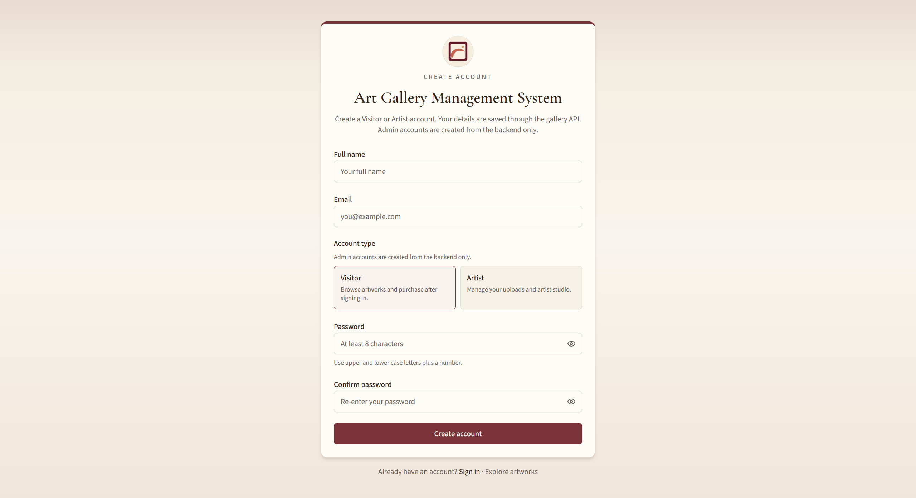
4. Signup Page
Art Gallery Management System | MCA Final Year Project
35 / 43

Slide 36
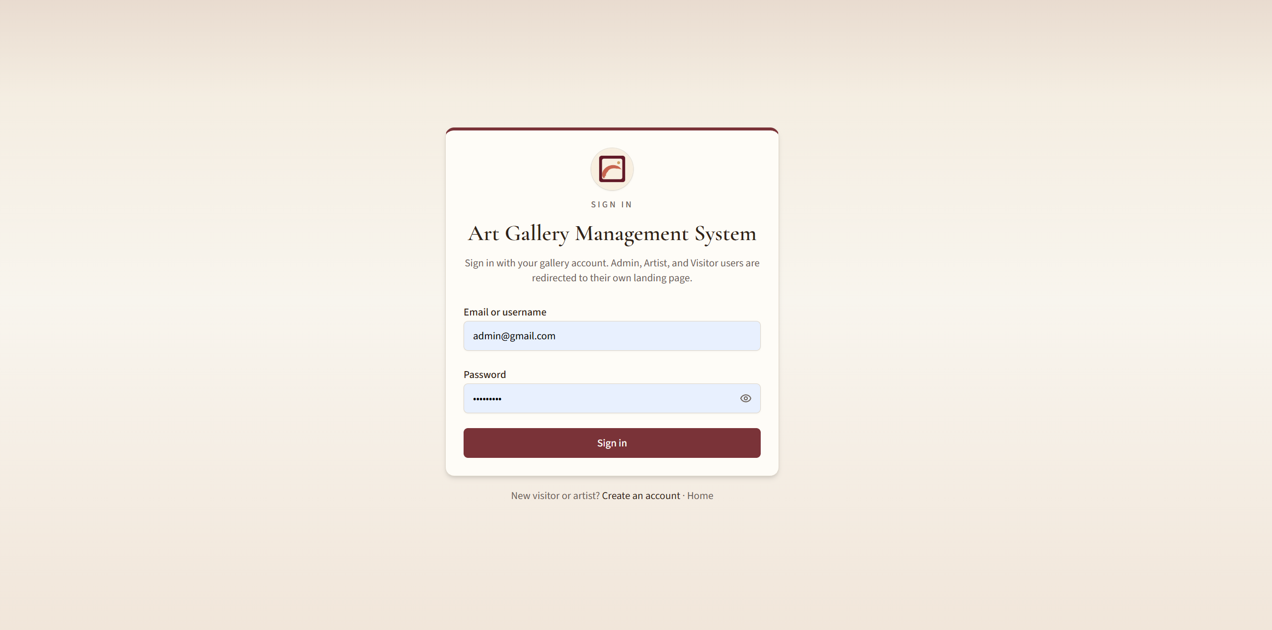
5. Signin Page
Art Gallery Management System | MCA Final Year Project
36 / 43

Slide 37
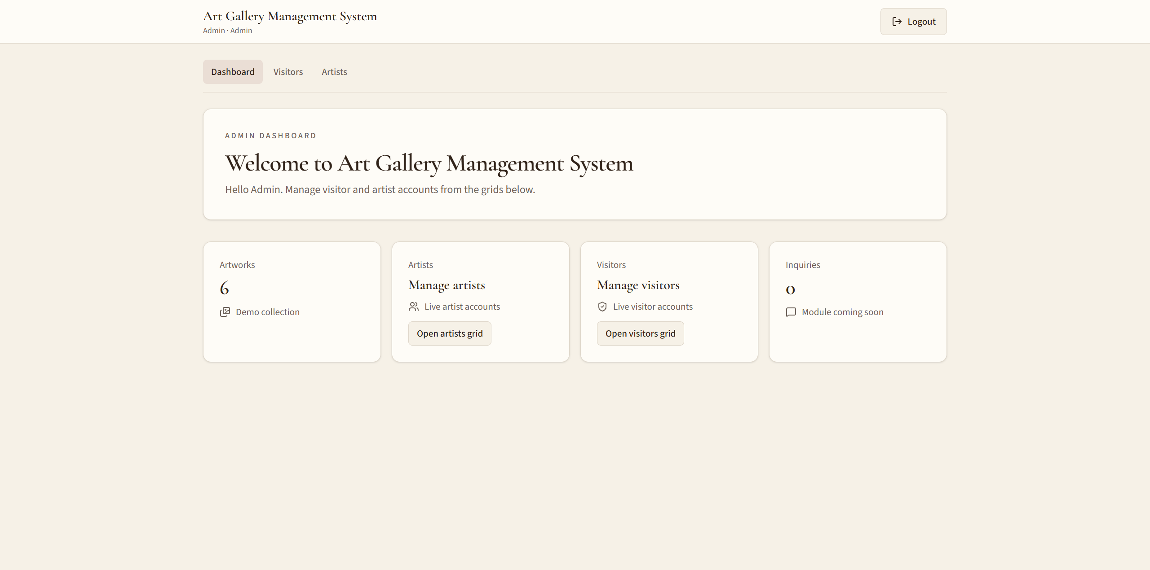
6. Admin Layout Page
Art Gallery Management System | MCA Final Year Project
37 / 43

Slide 38
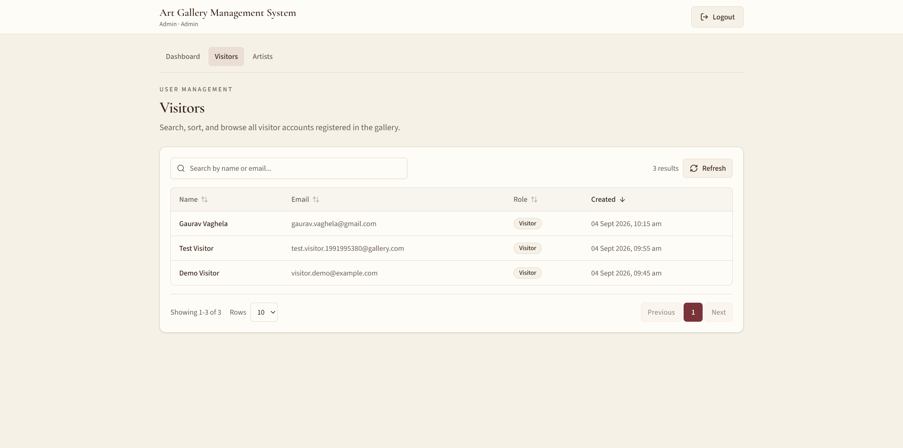
7. Visitor List Page
Art Gallery Management System | MCA Final Year Project
38 / 43

Slide 39
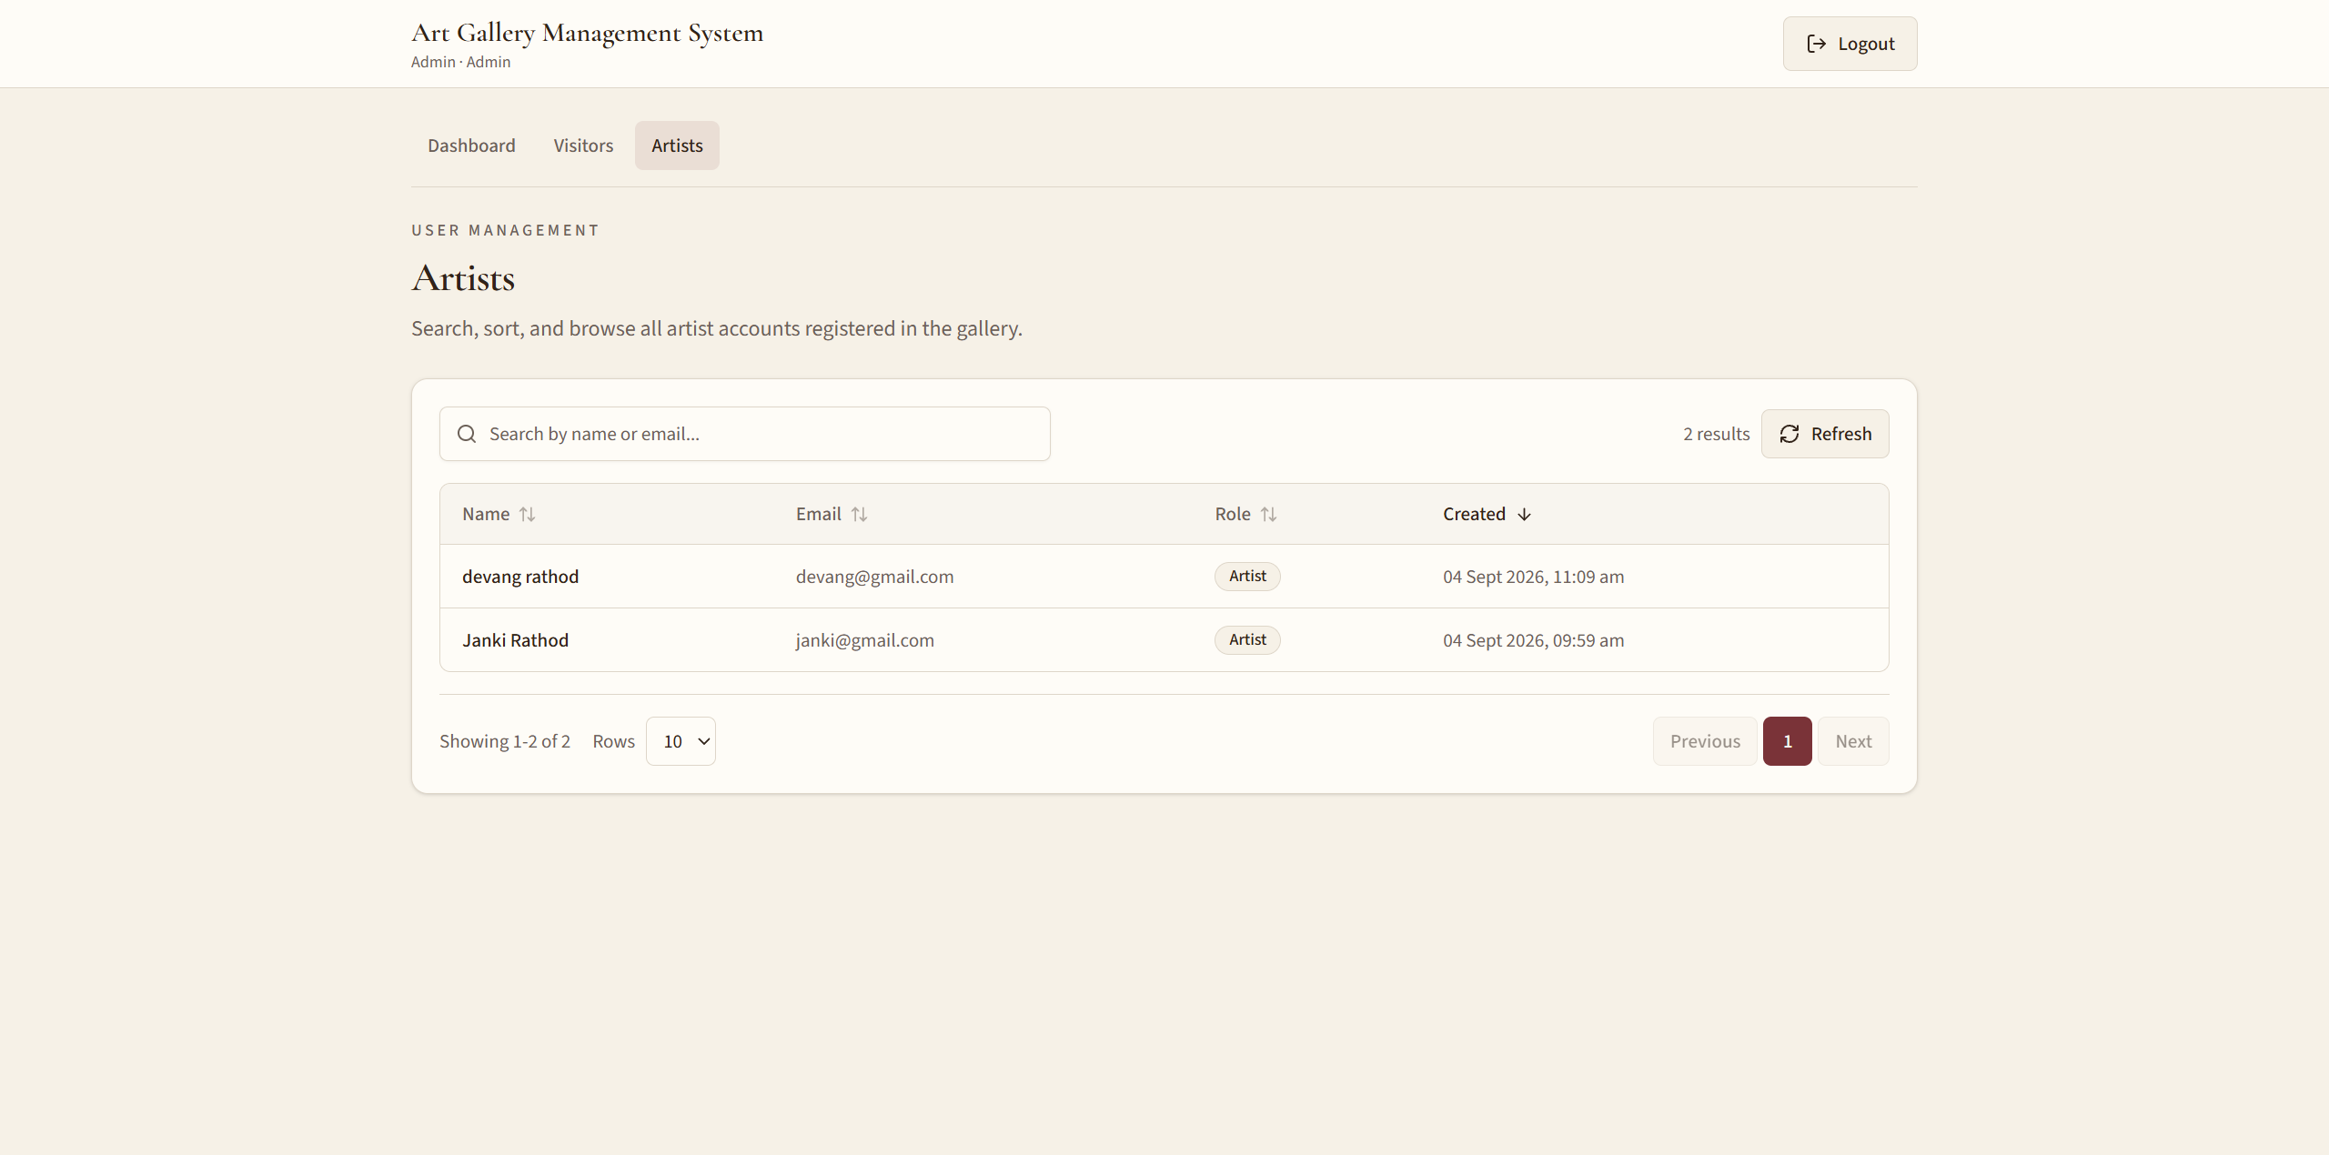
8. Artist List
Art Gallery Management System | MCA Final Year Project
39 / 43

Slide 40
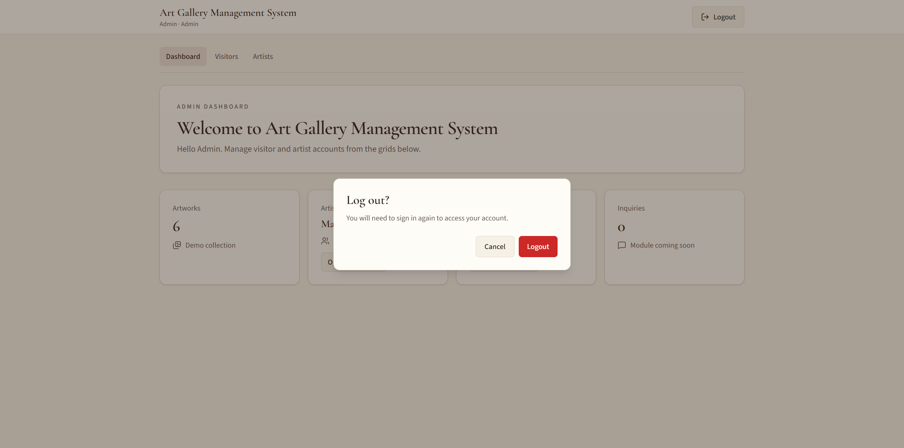
9. Signout Confirm
Art Gallery Management System | MCA Final Year Project
40 / 43

Slide 41
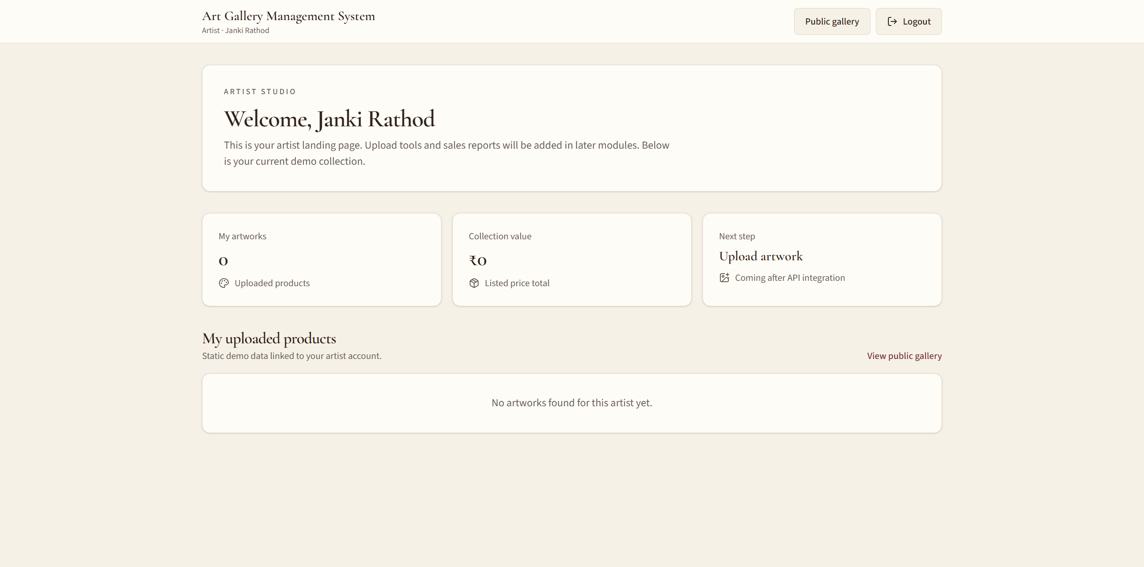
10. Artist studio Page
Art Gallery Management System | MCA Final Year Project
41 / 43

Slide 42
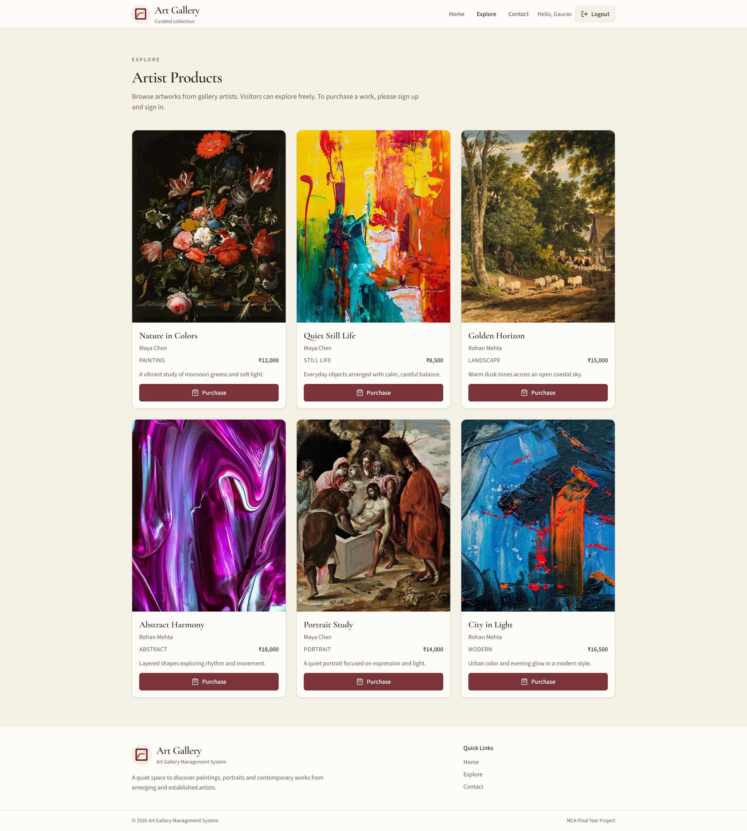
11. Visitor home page
Art Gallery Management System | MCA Final Year Project
42 / 43

Slide 43
Thank You
Questions and Answers
Art Gallery Management System | MCA Final Year Project

